Slide 1

Large Scale Machine Learning: Decision Trees
Note to other teachers and users of these slides: We would be delighted if you found our
material useful for giving your own lectures. Feel free to use these slides verbatim, or to
modify them to fit your own needs. If you make use of a significant portion of these slides
in your own lecture, please include this message, or a link to our web site: http://www.mmds.org
CS246: Mining Massive Datasets
Jure Leskovec, Stanford University
Mina Ghashami, Amazon
http://cs246.stanford.edu
Notes:
Building large scale machine learning models
Why it is a very useful model to know
DT are predictive models

Slide 2
Decision Trees: Learning Ensembles
Notes:
Usually we dont learn one DT. But we learn multiple DT

Slide 3
Learning Ensembles
Learn multiple trees and combine their predictions
The “wisdom of crowds”
A group/ ensemble of base learners that collectively achieve a better final prediction.
Decision trees are prone to
Overfitting (high variance and low bias) when it hasn’t been pruned
Underfitting (low variance and high bias) when it’s very small, i.e. a decision stump.
Ensemble reduces bias or variance, yielding better model performance.
Notes:
We saw this in netflix challenge. Two ensemble approach:
Bagging
Boosting
Bagging, also known as bootstrap aggregation, is the ensemble learning method that is commonly used to reduce variance within a noisy dataset. In bagging, a random sample of data in a training set is selected with replacement—meaning that the individual data points can be chosen more than once. After several data samples are generated, these weak models are then trained independently, and depending on the type of task—regression or classification, for example—the average or majority of those predictions yield a more accurate estimate.

Slide 4
Overview
Two techniques in ensemble learning:
Bagging
Instance bagging (bootstraps on instances)
Feature bagging (bootstraps on features) --> random forest
Boosting
Adaboost
GBDT

Slide 5
Learning Ensembles
There are two main types of ensemble learning:
Bagging and Boosting
Bagging (bootstrap aggregation):
Learns multiple trees in parallel over independent samples of the training data
1) Bootstrapping: Given a dataset, create multiple datasets by sampling data points randomly and with replacement.
2) Parallel training: Train decision trees on samples independently and in parallel with each other
3) Aggregation: Depending on the task (i.e. regression or classification), an average or a majority of the predictions are computed for a more accurate estimate.
Regression, an average is taken of all the outputs predicted by the individual classifiers; this is known as “soft voting”.
Classification, the class with the highest majority of votes is accepted; this is “hard voting” or majority voting.
Notes:
We saw this in netflix challenge. Two ensemble approach:
Bagging
Boosting
Bagging, also known as bootstrap aggregation, is the ensemble learning method that is commonly used to reduce variance within a noisy dataset. In bagging, a random sample of data in a training set is selected with replacement—meaning that the individual data points can be chosen more than once. After several data samples are generated, these weak models are then trained independently, and depending on the type of task—regression or classification, for example—the average or majority of those predictions yield a more accurate estimate.

Slide 6
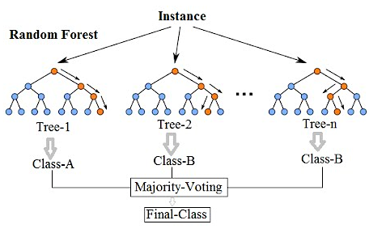
(1): Bagging Decision Trees

Slide 7
(2) Improvement: Random Forests
So far we did instance bagging.
Decision trees are greedy
They choose which variable to split on using a greedy algorithm that minimizes error.
Even with Bagging, the decision trees can have a lot of structural similarities and in turn have high correlation in their predictions.
Feature Bagging
Pick a random sample of features at each split
less correlation among trees
Random forest
Notes:
Feature bagging leads to very robust models as invididual models are uncorrelated.

Slide 8
Ensemble learning
Assumption: Low/zero correlations
Bagging helps with less correlation
Instance & feature

Slide 9
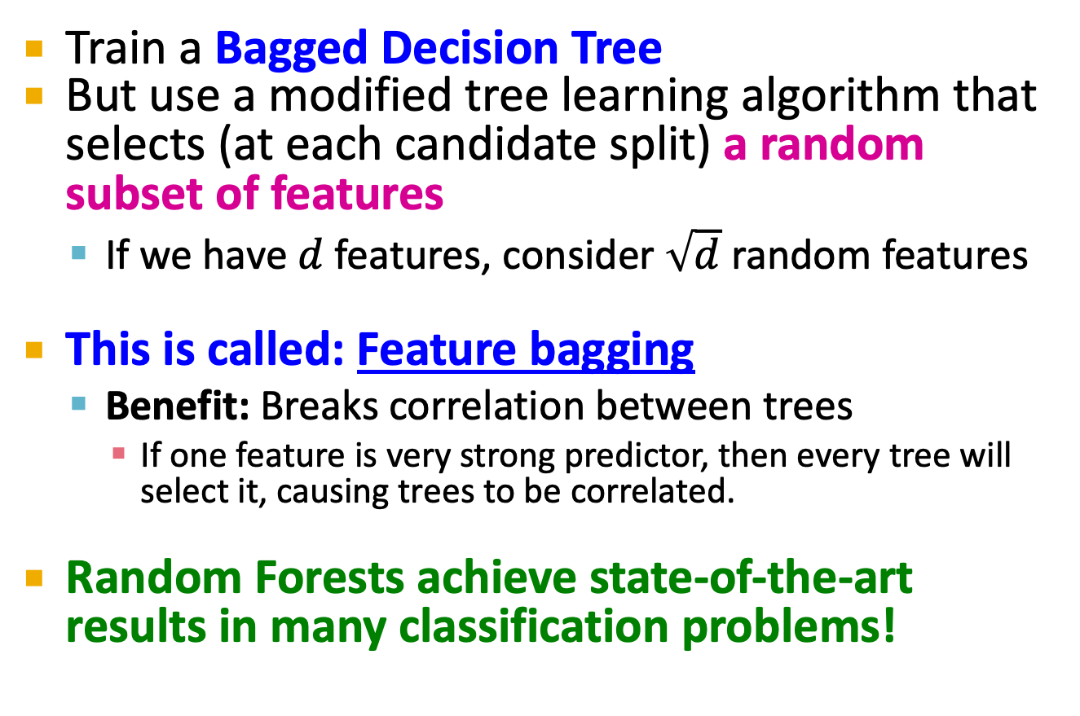
(2) Improvement: Random Forests
Train a Bagged Decision Tree
But use a modified tree learning algorithm that selects (at each candidate split) a random subset of features
If we have $d$ features, consider $\sqrt{d}$ random features
This is called: Feature bagging
Benefit: Breaks correlation between trees
If one feature is very strong predictor, then every tree will select it, causing trees to be correlated.
Random Forests achieve state-of-the-art results in many classification problems!
Notes:
Feature bagging leads to very robust models as invididual models are uncorrelated.

Slide 10
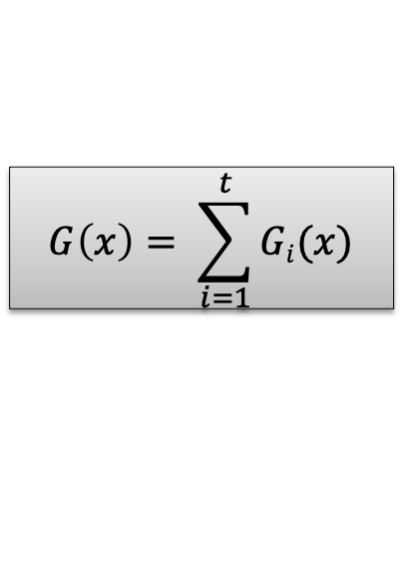
(3): Boosting
Boosting: Another ensemble learning algorithm
Combines the outputs of many “weak” classifiers to produce a powerful “committee”
Learns multiple trees sequentially, each trying to improve upon its predecessor
Final classifier is weighted sum of the individual classifiers
Data re-weighting based on residual
...
Final Model
Data
G₁(x)
G₂(x)
G_{t}(x)
G(x)
x
$$G\left(x\right)= \sum_{i=1}^{t}{Gi(x)}$$
Residual: Difference between prediction and ground truth
Notes:
Each next tree improves over mistakes of the previuos tree

Slide 11
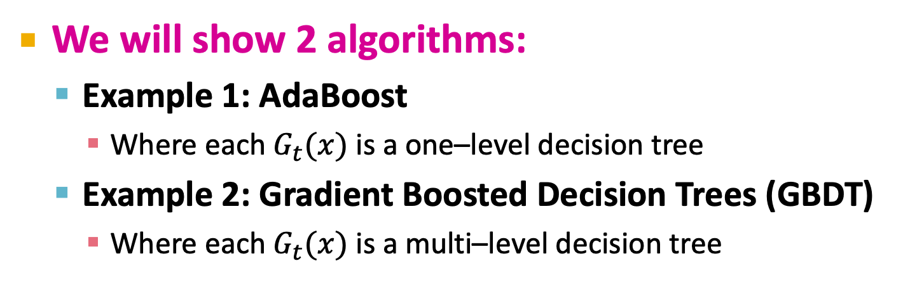
(3): Boosting
We will show 2 algorithms:
Example 1: AdaBoost
Where each $G_{t}(x)$ is a one–level decision tree
Example 2: Gradient Boosted Decision Trees (GBDT)
Where each $G_{t}(x)$ is a multi–level decision tree
Data re-weighting based on residual
...
Final Model
Data
G₁(x)
G₂(x)
G_{t}(x)
G(x)
x
$$G\left(x\right)= \sum_{i=1}^{t}{Gi(x)}$$
Residual: difference between prediction and ground truth
Notes:
GBDT is the state of the art.

Slide 12
AdaBoost
AdaBoost = Adaptive Boosting
It builds many weak learners and ensembles their predictions
The individual learners can be weak, but as long as the performance of each one is slightly better than random guessing, the final model converge to a strong learner.
Every weak learner used in AdaBoost is tweaked in favor of instances misclassified by previous weak learners.

Slide 13
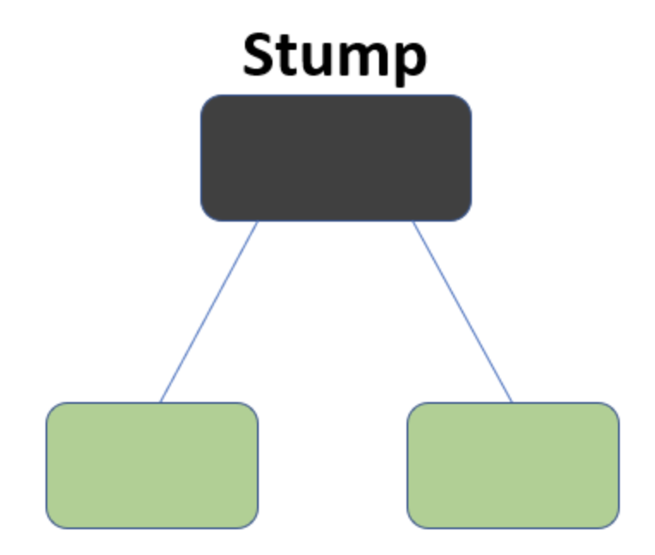
AdaBoost: Weak learner
Decision “stumps”:
1-level decision tree
A decision boundary based on one feature
E.g.: If someone is not a smoker, then predict them to live past 80 years old
Building blocks of AdaBoost algorithm
Decision stump is a weak learner
+
+
+
Boosting theory: if weak learners have
>50% accuracy then we can learn a perfect classifier.
–
–
+
–
A decision stump
Notes:
Developped in theoretical ML community, so it is theoretically very well understood

Slide 14






Build Decision Trees with AdaBoost
Suppose we have training data ,
Initialize equal weights for all observations
At each iteration t:
Train a stump using data weighted by
Compute the misclassification error adjusted by
Compute the weight of the current tree
Reweight each observation based on prediction accuracy
Notes:
W_i is the importance of each datapoint. The idea is ithat if a point is missclassified we increase its weight so that next iteration the algorithm corrects for it.

Slide 15
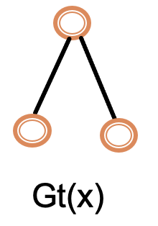
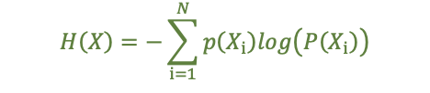

Training One Decision Tree
Step1- Train a stump. How to split?
Apply weighting to the splitting criterion function
and optimize the function to find the best split
We'll use information gain as an example
Recall :
Information gain
where
After weighting:

Slide 16

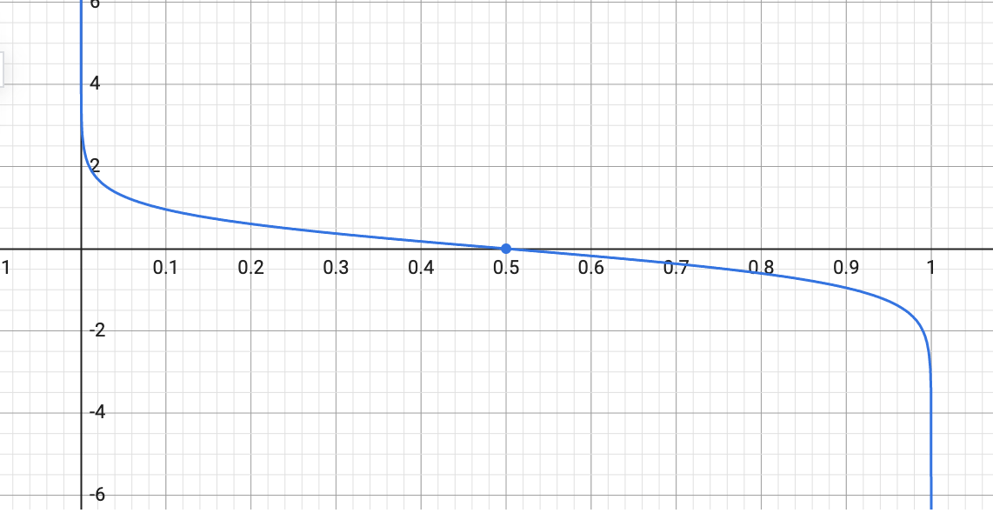


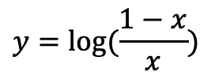
Update Step
Step2- Calculate the weighted misclassification error
Step3- Weight the current tree
in the final classifier:
Step4- Use misclassification error and tree weight to reweight the training data:
$$y=log⁡(\frac{1−x}{x})$$
A classifier with 50% accuracy is given a weight of zero;
Harder to classify training instances get higher weight
Notes:
Weight of correclty classified instances remain the same

Slide 17
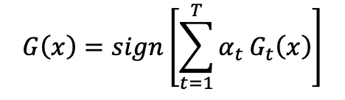
Final Prediction
Final prediction is a weighted sum of the predictions from each stump:
More accurate trees are weighted higher in the final model
Notes:
More accurate trees have higher weight

Slide 18
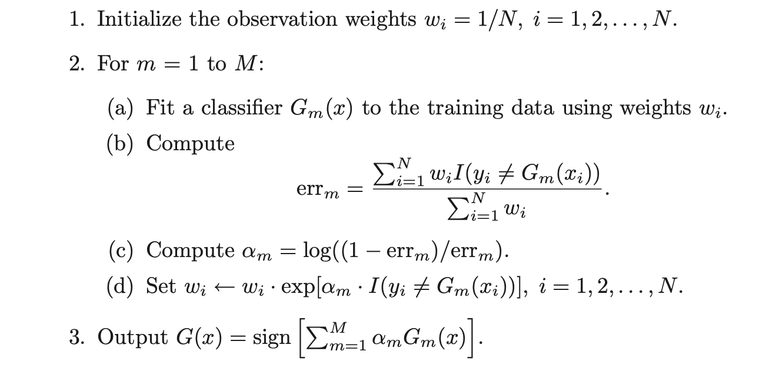
AdaBoost: Summary
（1）Train a stump
（2）Compute error
（3）Compute tree weight
（4）Reweight data

Slide 19
AdaBoost Conclusion
Iteratively train weak learners (decision stumps) to form a strong model:
Trees with high accuracy are given more weights in the final model
Misclassified data get higher weights in the next iteration

Slide 20
Gradient Boosted Decision Trees
Notes:
Usually we dont learn one DT. But we learn multiple DT

Slide 21
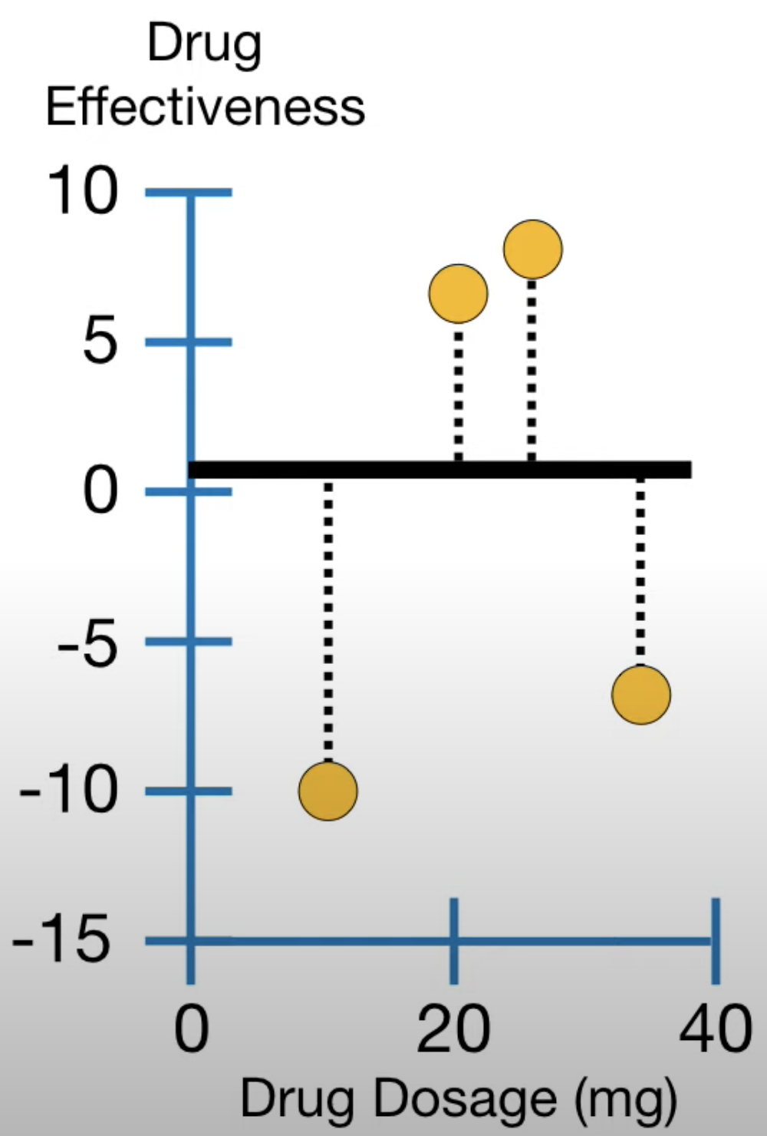
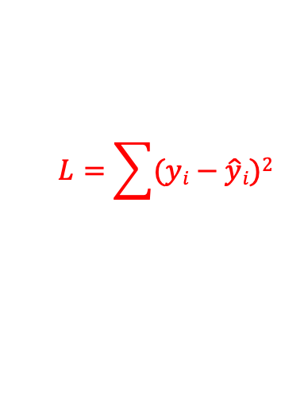
Gradient Boosted Decision Trees
Idea:
Start with a constant prediction, add a new decision tree each time. It can be multi-level!
Let’s see it in an example for regression.
drug dosage (x) | drug effectiveness (y)
10 | -10
20 | 7
25 | 8
35 | -7
Since problem is regression, the loss function is
$$L=\sum{(yi−\hat{y}i})2$$

Slide 22
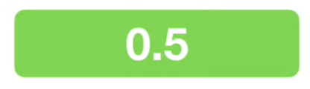
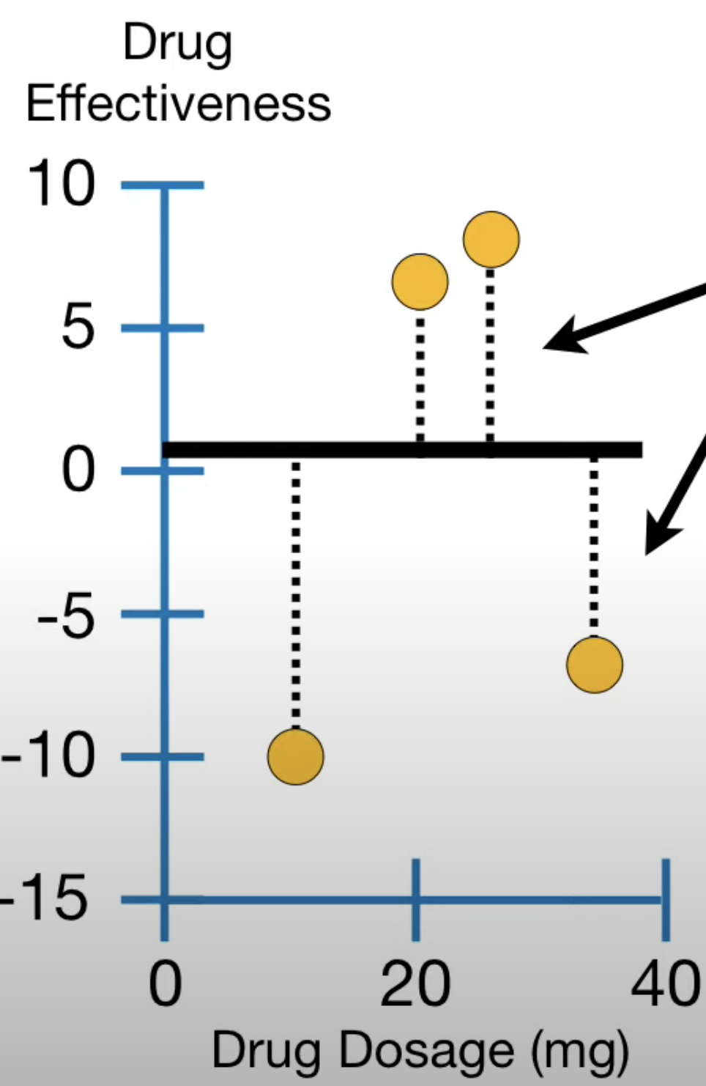
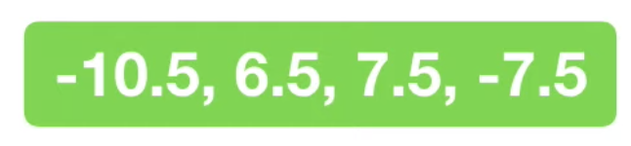


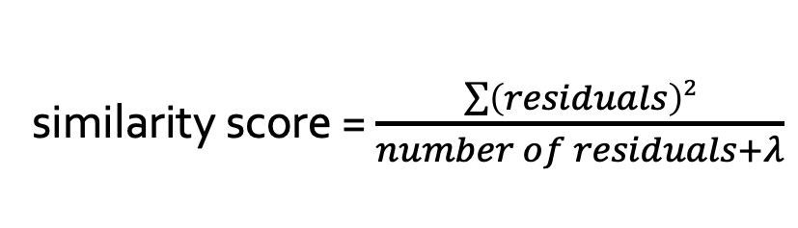
Gradient Boosted Decision Trees
Start with a constant prediction:
Compute residuals = observed – predicted
Build next tree by putting
All residuals into a leaf
Compute similarity score
$\hat{y}i$⁽⁰⁾ = 0.5
residuals
similarity score = $\frac{\sum{\left(residuals\right)2}}{number of residuals+λ}$
$λ$is a regularization hyperparameter

Slide 23
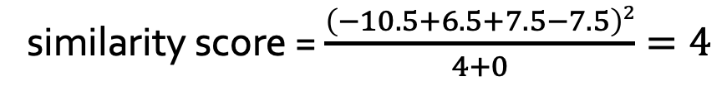

Gradient Boosted Decision Trees
Let’s set
$$λ=0$$
similarity score = $\frac{\left(−10.5+6.5+7.5−7.5\right)2}{4+0}=4$

Slide 24
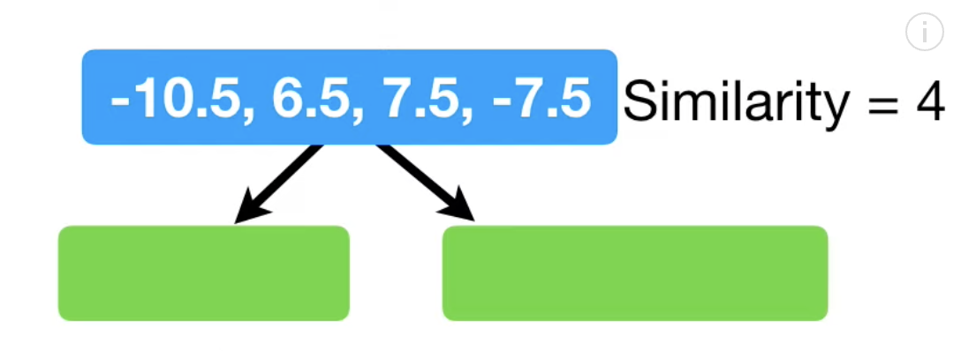
Gradient Boosted Decision Trees
Let’s set
Let’s grow the tree:
$$λ=0$$
similarity score = $\frac{\left(−10.5+6.5+7.5−7.5\right)2}{4+0}=4$
Dosage < 15

Slide 25
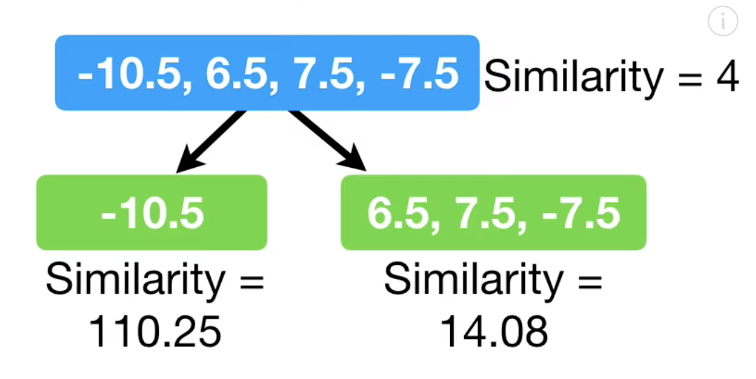
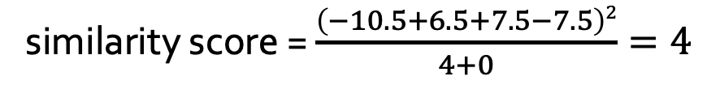
Gradient Boosted Decision Trees
Let’s set
Let’s grow the tree:
$$λ=0$$
similarity score = $\frac{\left(−10.5+6.5+7.5−7.5\right)2}{4+0}=4$
Dosage < 15

Slide 26
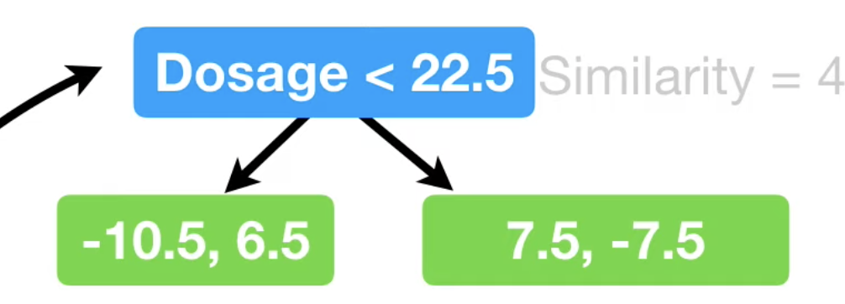

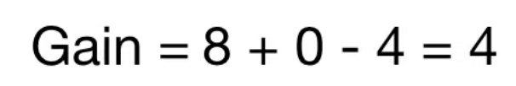
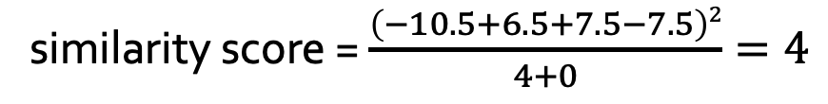
Gradient Boosted Decision Trees
Let’s set
Let’s grow the tree:
$$λ=0$$
similarity score = $\frac{\left(−10.5+6.5+7.5−7.5\right)2}{4+0}=4$
Dosage < 22.5
Similarity = 4
Similarity = 8
Similarity = 0

Slide 27
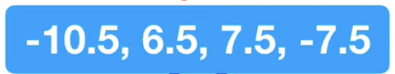

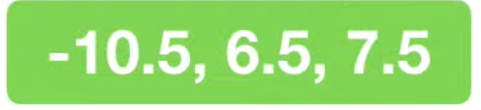
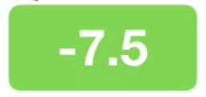

Gradient Boosted Decision Trees
Let’s set
Let’s grow the tree:
$$λ=0$$
similarity score = $\frac{\left(−10.5+6.5+7.5−7.5\right)2}{4+0}=4$
Dosage < 30
Similarity = 4
Similarity = 4.08
Similarity = 56.25

Slide 28

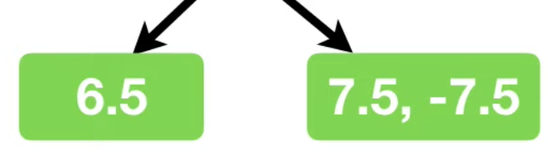
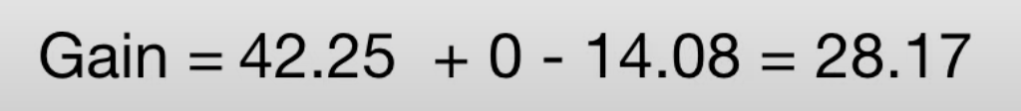
Gradient Boosted Decision Trees
So far:
Dosage < 22.5
Similarity = 42.25
Similarity = 0

Slide 29
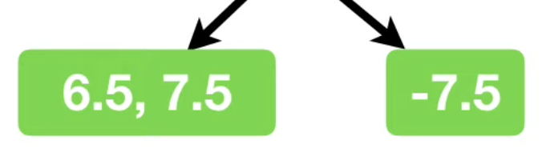
Gradient Boosted Decision Trees
So far:
Dosage < 30
Similarity = 98
Similarity = 56.25

Slide 30

Gradient Boosted Decision Trees
So far we have:
Let’s assume we are done growing this tree!

Slide 31
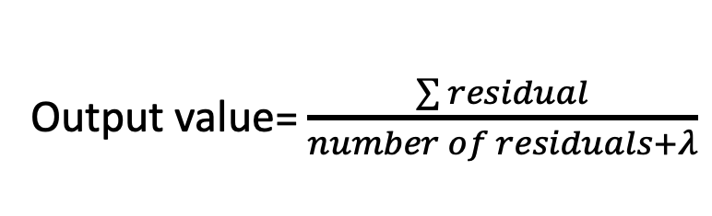
Gradient Boosted Decision Trees
So far we have:
To make predictions:
Compute an output value for each leaf
output = -10.5
output = 7
output =-7.5
Output value= $\frac{\sum{residual}}{number of residuals+λ}$

Slide 32
Gradient Boosted Decision Trees
So far we have:
output = -10.5
output = 7
output =-7.5
New prediction=0.5 + 0.3 x(-10.5)=-2.65

Slide 33
Gradient Boosted Decision Trees
So far we have:
output = -10.5
output = 7
output =-7.5
New prediction=0.5 + 0.3 x7=2.6
Notes:
0.5+0.3*(-7.5)

Slide 34
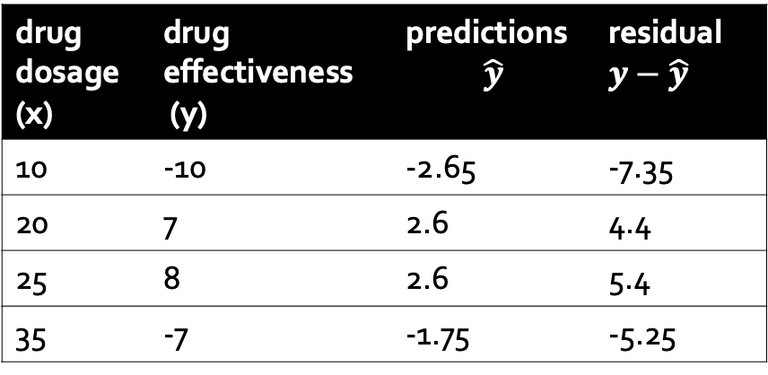
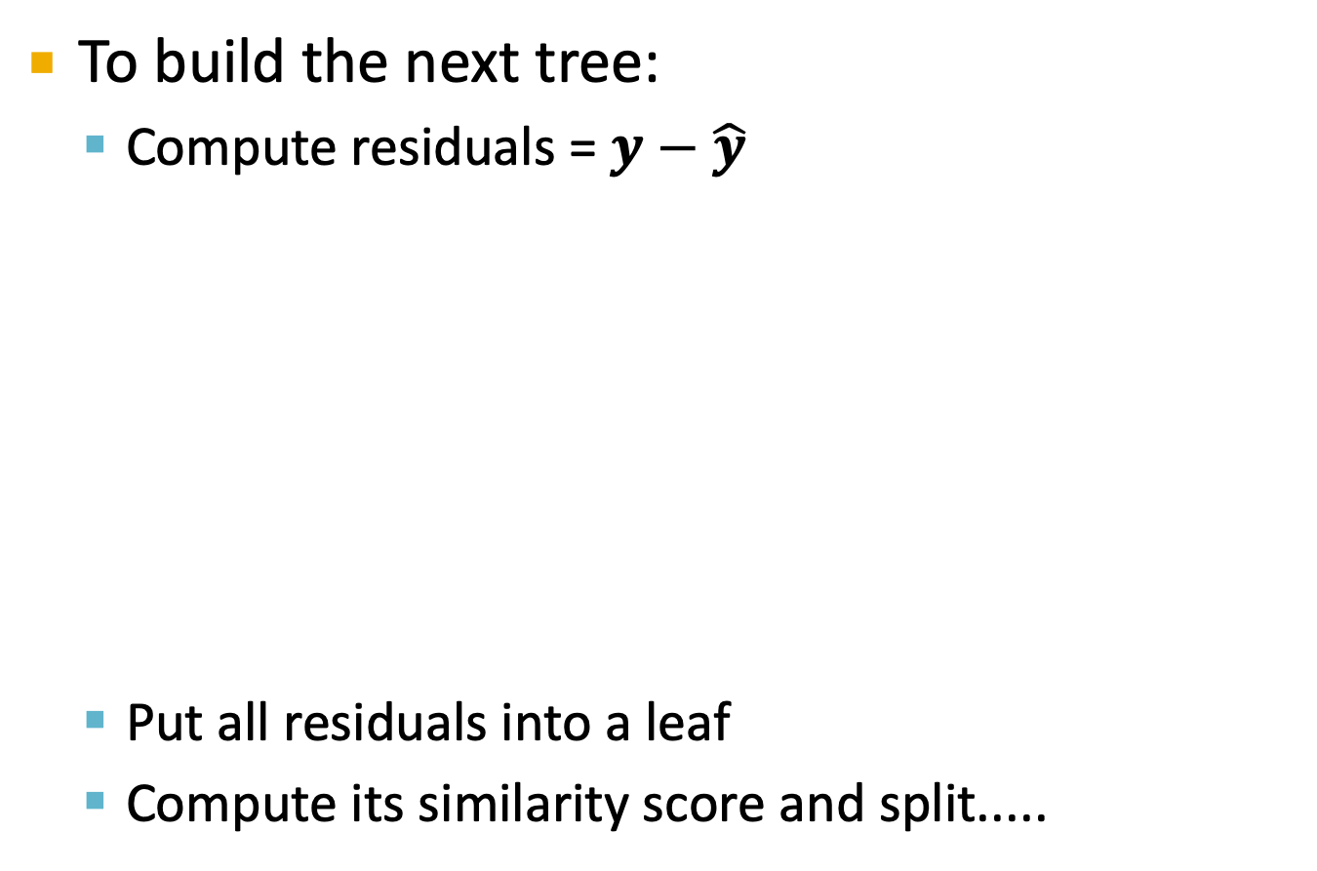
Gradient Boosted Decision Trees
To build the next tree:
Compute residuals = $y−\hat{y}$
Put all residuals into a leaf
Compute its similarity score and split.....
drug dosage (x) | drug effectiveness (y) | predictions $$\hat{y}$$ | residual$y−\hat{y}$
10 | -10 | -2.65 | -7.35
20 | 7 | 2.6 | 4.4
25 | 8 | 2.6 | 5.4
35 | -7 | -1.75 | -5.25
-7.35, 4.4, 5.4, -5.25

Slide 35
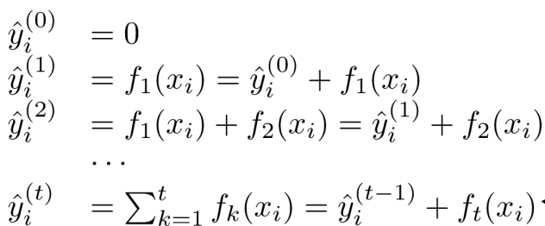
Gradient Boosted Decision Trees
XGBoost: A Scalable Tree Boosting System, T. Chen etal, KDD2016
Now let’s look at the math
Prediction at training round t
Keep predictions from previous rounds
New model
Notes:
https://homes.cs.washington.edu/~tqchen/pdf/BoostedTree.pdf
xgboost

Slide 36

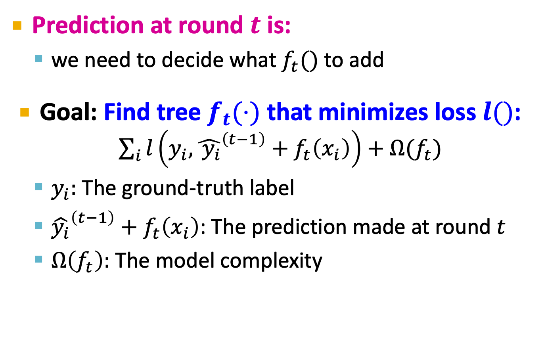
How to decide which f to add?
Prediction at round $t$ is:
we need to decide what $f_{t}()$ to add
Goal: Find tree $f_{t}(⋅)$ that minimizes loss $l()$: $\sum_{i}{l\left(y_{i}, {\hat{ y_{i}}}^{\left(t−1\right)}+f_{t}\left(x_{i}\right)\right)+Ω(f_{t})}$
$y_{i}$: The ground-truth label
${\hat{y_{i}}}^{\left(t−1\right)}+f_{t}\left(x_{i}\right)$: The prediction made at round $t$
$Ω\left(f_{t}\right):$ The model complexity

Slide 37
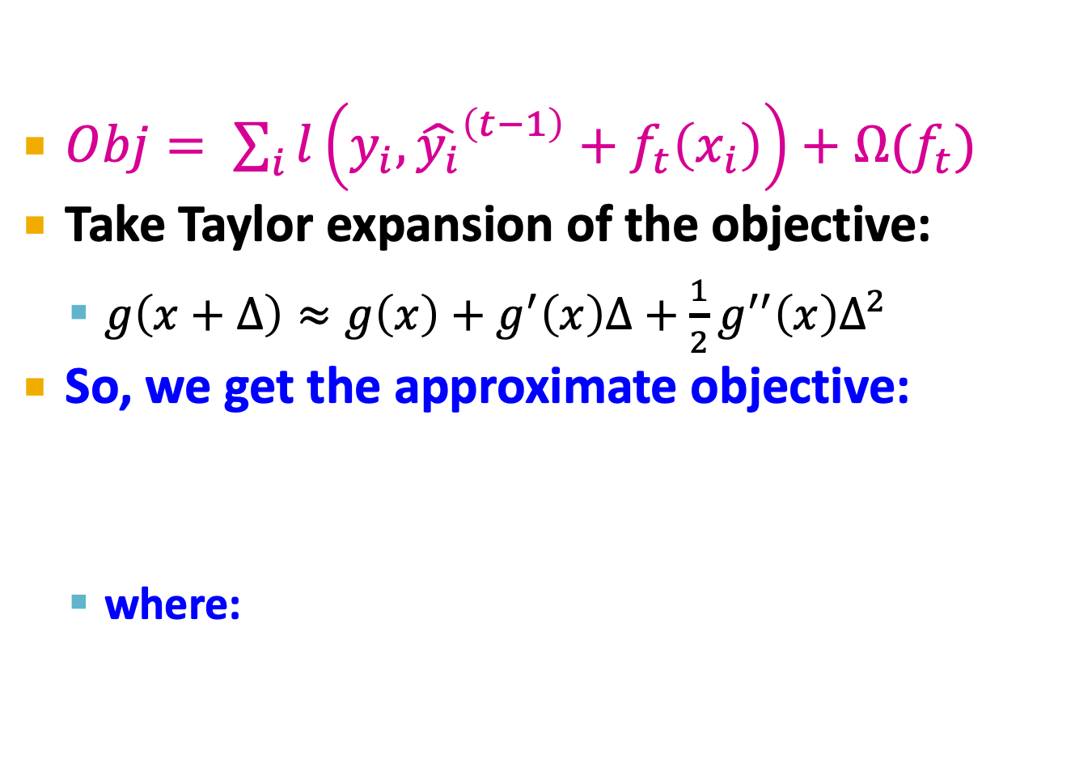

How to decide which $f$ to add?
$Obj= \sum_{i}{l\left(y_{i}, {\hat{y_{i}}}^{\left(t−1\right)}+f_{t}\left(x_{i}\right)\right)+Ω(f_{t})}$
Take Taylor expansion of the objective:
$g\left(x+Δ\right)≈g\left(x\right)+g^{′}\left(x\right)Δ+\frac{1}{2}g^{′′}\left(x\right)Δ^{2}$
So, we get the approximate objective:
where:
We can ignore this part, since we are optimizing over $f_{t}$

Slide 38
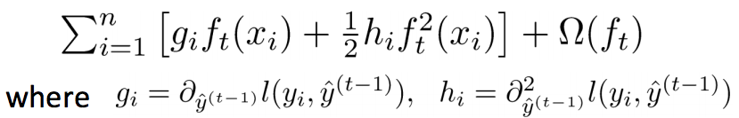
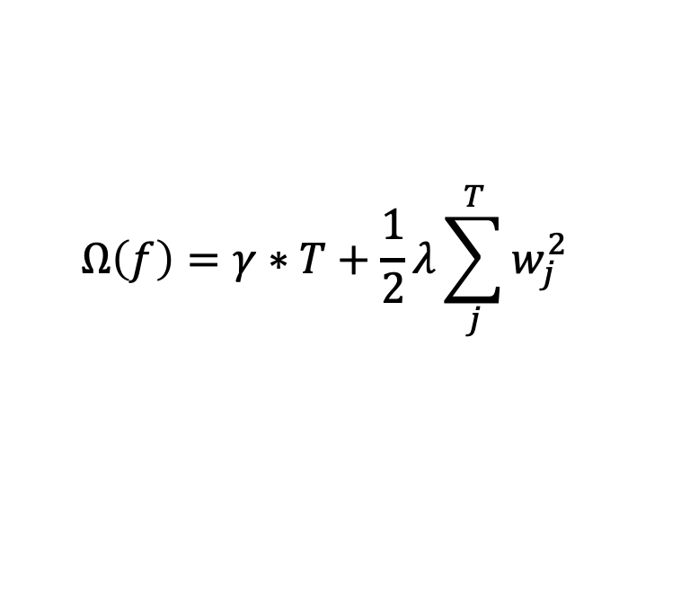

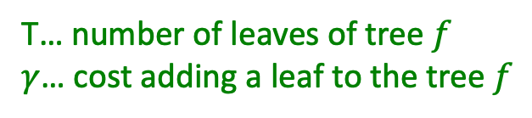
How to decide which f to add?
The approximate objective:
Define model complexity of tree f as
$$Ω\left(f\right)=γ∗T+\frac{1}{2}λ\sum_{j}^{T}{w_{j}^{2}}$$
A
B
C
D
E
T… number of leaves of tree $f$
$γ$… cost adding a leaf to the tree $f$
$w_{j}$is output value of j-th leaf

Slide 39
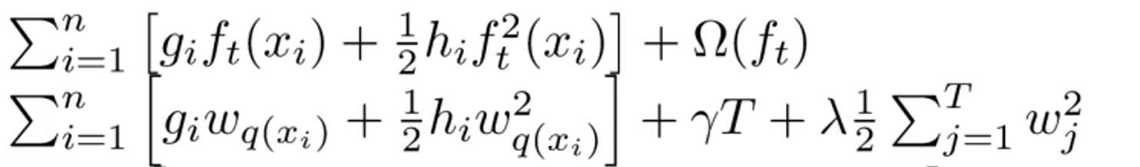

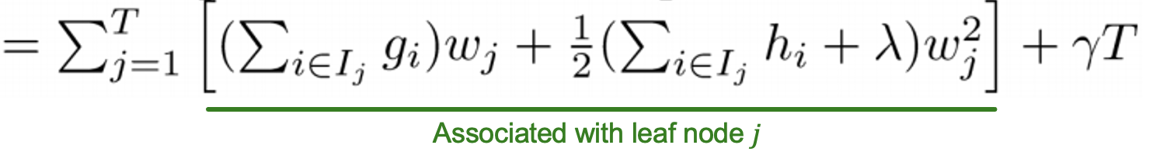


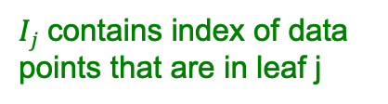
Revisiting the Objective
So our objective is:
We can re-write it by leaf
Notice this is a sum of $T$ quadratic functions, each function is associated with a leaf node $j$
$Ij$ contains index of data points that are in leaf j
q(x) denotes the leaf that data point x belongs to
Associated with leaf node $j$

Slide 40
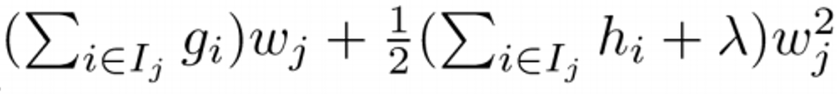


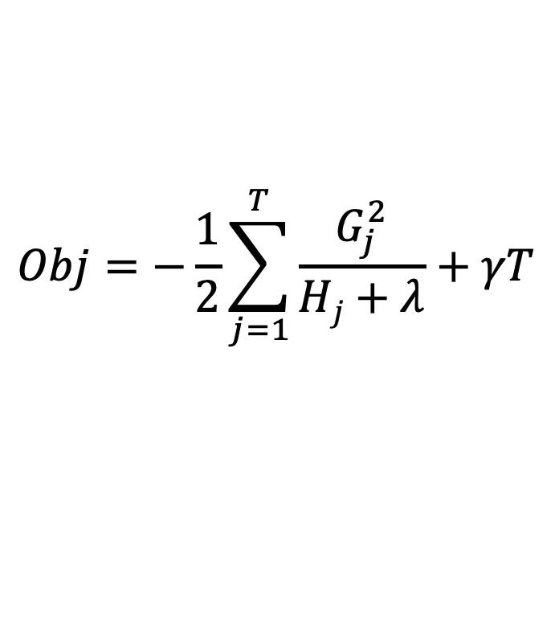

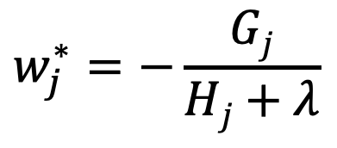
Finding the Optimal $w_{j}^{∗}$
Each quadratic function associated with leaf j:
The minimizer is:
The minimum value of objective is:
$$w_{j}^{∗}=−\frac{Gj}{Hj+λ}$$
The Obj function measures the quality of the set of T trees. This score is like the impurity score for evaluating decision trees, except that it is derived for a wider range of objective functions
$$Obj=−\frac{1}{2}\sum_{j=1}^{T}{\frac{G_{j}^{2}}{Hj+λ}+γT}$$

Slide 41



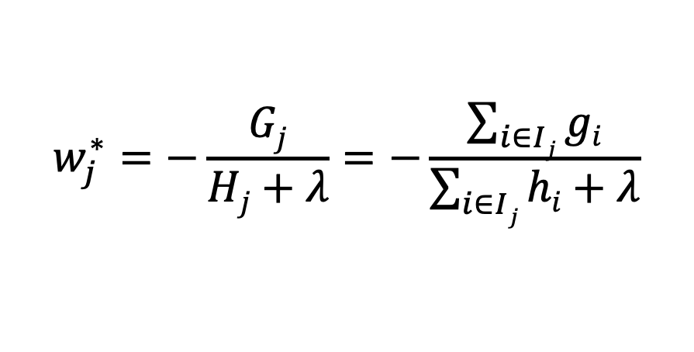
For Regression Loss
Derive $g$ and $h$ for square loss:
And
$$w_{j}^{∗}=−\frac{Gj}{Hj+λ}=−\frac{\sum_{i∈Ij}{gi}}{\sum_{i∈Ij}{hi}+λ}$$

Slide 42
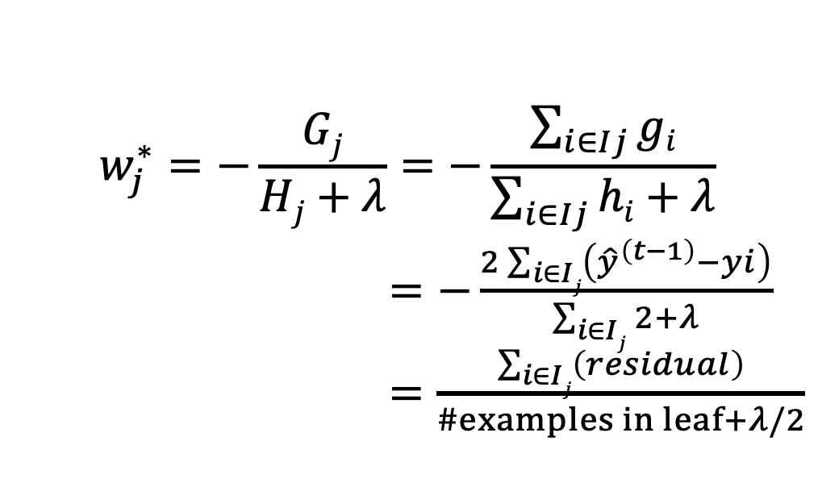
For Regression Example
Derive $g$ and $h$ for square loss:
And
$$w_{j}^{∗}=−\frac{Gj}{Hj+λ}=−\frac{\sum_{i∈Ij}{gi}}{\sum_{i∈Ij}{hi}+λ}$$
$=−\frac{2\sum_{i∈Ij}{\left({\hat{y}}^{\left(t−1\right)}−yi\right)}}{\sum_{i∈Ij}{2}+λ}$
$=\frac{\sum_{i∈Ij}{\left(residual\right)}}{\#examples in leaf+λ/2}$
This is the output value we saw before

Slide 43
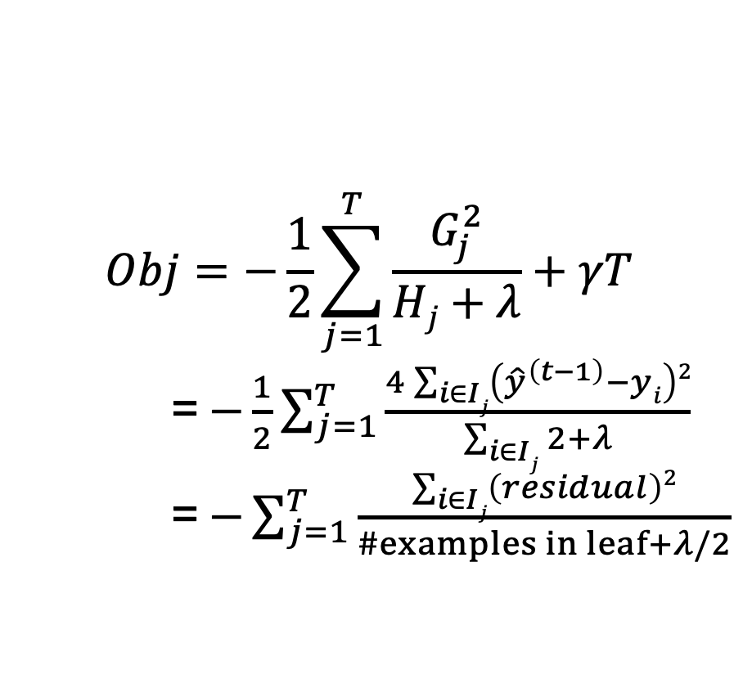
For Regression Example
Derive $g$ and $h$ for square loss:
And
$$Obj=−\frac{1}{2}\sum_{j=1}^{T}{\frac{G_{j}^{2}}{Hj+λ}+γT}$$
= $−\frac{1}{2}\sum_{j=1}^{T}{\frac{4\sum_{i∈Ij}{\left({\hat{y}}^{\left(t−1\right)}−yi\right)2}}{\sum_{i∈Ij}{2}+λ}}$
= $−\sum_{j=1}^{T}{\frac{\sum_{i∈Ij}{\left(residual\right)2}}{\#examples in leaf+λ/2}}$
we saw this in similarity score

Slide 44




How to find a single tree $f_{t}$
Given a tree $f_{t}$, we know how to
Calculate the score for $f$:
And then set optimal weights for the chosen $f$:
In principle we could:
Enumerate possible tree structures $f$ and take the one that minimizes $Obj$

Slide 45
How to find a single tree $f_{t}$
In practice we grow tree greedily:
Start with tree with depth 0
For each leaf node in the tree, try to add a split
The change of the objective after adding a split is:
Take the split that gives best gain
Next: How to find the best split?
similarity score
of left child
Similarity score
of right child
Similarity score
of parent

Slide 46
How to Find the Best Split?
For each node, enumerate over all features
For each feature, sort the instances by feature value
Use a linear scan to decide the best split along that feature
Take the best split solution along all the features
Pre-stopping:
Stop split if the best split have negative gain
But maybe a split can benefit future splits..
Post-Prunning:
Grow a tree to maximum depth, recursively prune all the leaf splits with negative gain.

Slide 47





Summary: GBDT Algorithm
Add a new tree $f_{t}(x)$ in each iteration
Compute necessary statistics for our objective
Greedily grow the tree that minimizes the objective:
Add $f_{t}(x)$ to our ensemble model
Repeat until we use $M$ ensemble of trees
$η$ is called step-size or shrinkage, usually set around 0.1 to 0.3 to prevent overfitting
$y^{(t)}=$ $y^{(t−1)}+ηf_{t}(x_{i})$

Slide 48
XGBoost
XGBoost: eXtreme Gradient Boosting
A highly scalable implementation of gradient boosted decision trees with regularization
Widely used by data scientists and provides state-of-the-art results on many problems!
System optimizations:
Parallel tree constructions using column block structure
Distributed Computing for training very large models using a cluster of machines.
Out-of-Core Computing for very large datasets that don’t fit into memory.

